Slide 1


Major-1 Project
Title : Online Streaming Platform
Presented by:
R110219027-Astha Kumari
R110219043-Devanshu Pathak
R110219041-Devang Tyagi
R110219053-Gaurav Kumar
Mentored By-:
Vijay Prakash
Associate Professor
School of Systemics

Slide 2
Name | Roll-no | Sap-id | Contribution
Astha Kumari | R110219027 | 500076107 | Research,Technical,Documentation
Devanshu Pathak | R110219043 | 500075792 | Research,Technical,Documentation
Devang Tyagi | R110219041 | 500077078 | Research,Technical,Documentation
Gaurav Kumar | R110219053 | 500076068 | Research,Technical,Documentation

Slide 3
Content
Introduction
Motivation
Problem Statement
Objectives
Methodology
Literature Review
Technological Stack
Working Model (Technical Diagrams)
SWOT Analysis
Area of Application
Pert Chart
References

Slide 4
Introduction
An “Online Streaming Platform” is an on demand online entertainment source for TV shows, movies and other streaming media. There is a substantial need of creating static buckets with transcoded videos to deal with the problem of network latency with respect to the availability zone in which the server for the same application is hosted . Hence the application deals with the same methodology of creating transcoded buckets using the lambda triggers to solve the problem in real time environment .

Slide 5
Motivation
The problem of creating an on premises server with high level cost infrastructure for setting up both primary and secondary nodes causes system to crash in old monolithic if more service requests are hitting the primary nodes resulting into a 72 hours downtime . The solution to which is simply exchange them with cloud architecture solution and simple lambda triggers.
Video streams can take a brands’ inbound marketing to a new level. Thanks to the low cost, they’re affordable for small businesses and individuals which can later be scaled.

Slide 6
Problem Statement
The old architecture is now being replaced with transcoded buckets of various file format like 480p in order to provide a better watching experience to user available in any zone rather then relying on old monolithic architecture which did not have the capability to be both scaled up and down with disaster recovery at time of thousands of requests hitting at one particular time. Hence there is a need of more efficient solution to handle several request at a time without primary node failure.

Slide 7
Objectives
To design an encoding pipeline that converts uploaded videos to web-friendly 480p format
To design a push-based event-driven updates for website using lambda triggers . Users can automatically watch new videos without having to refresh their browser.
To create a user friendly interface for uploading and downloading of the same videos by user

Slide 8
Methodology
We would require two buckets in S3. The first bucket will serve as the upload bucket for new videos. The second bucket will contain transcoded videos put there by the Elastic Transcoder.
Further we need to create an IAM role for our future Lambda functions. This role will allow functions to interact with S3 and the Elastic Transcoder.
Now we need to set up an Elastic Transcoder pipeline to perform video transcoding to different formats and bitrates.
It is finally time to create the first Lambda function, although we are not going to provide an implementation for it just yet.
Finally, we can have a look at the actual Lambda function and deploy it to AWS.

Slide 9
Literature Review
Agarwal et. al [1] proposes online streaming function presented to the end user or the target audience is continuously received by the provider with the most central and well- known services such as Amazon EC2 and Amazon S3.
Li et. al [2] proposes that cloud technology is adopted due to the great features provided to video stream providers, such as high flexibility of using virtual machines and storage servers at low prices. Video streaming providers prepare multiple formats of the same video to satisfy the device specifications of all users.
Iturriaga et. al [3] states that when we transcode the videos on Amazon Elastic Cloud Computing (EC2) or Virtual Machines (VMs) to further study realistic cloud settings with fine-tuned configurations. Our experiments show the superior performance of some codecs and the effects of machine configurations on transcoding tasks duration. Which generalizes to the idea of a benchmark for practitioners and researchers considering online transcoding in real-time multimedia applications .

Slide 10
Technical Stack
Platform used : Amazon Web Services
Services of AWS Used : 1. EC2 instance
2. S3 Bucket
3. AWS lambda

Slide 11
SWOT Analysis
Strength
Uses encoded buckets hence no network latency issues.
The model can be scaled up and down accordance to the need of business.
Weakness
The model still requires working on android interfaces.
The rising demand for storage capacity is due to increased electricity, energy, and fibre capacity use. To handle the multiple versions that are generated, more storage is required.
Opportunity
Replacing the old monolithic architecture with simple cloud platform with no downtown issues leading various business opportunity like advertising.
We can even automate several functionality daily functionality making more practically feasible.
Threat
In modern era website like these are prone to attacks which can lead to loss of data and integrity of users.
Because the content displayed on these platforms is unregulated, various petitions have been filed in courts seeking to impose restrictions on the content displayed on these platforms.

Slide 12
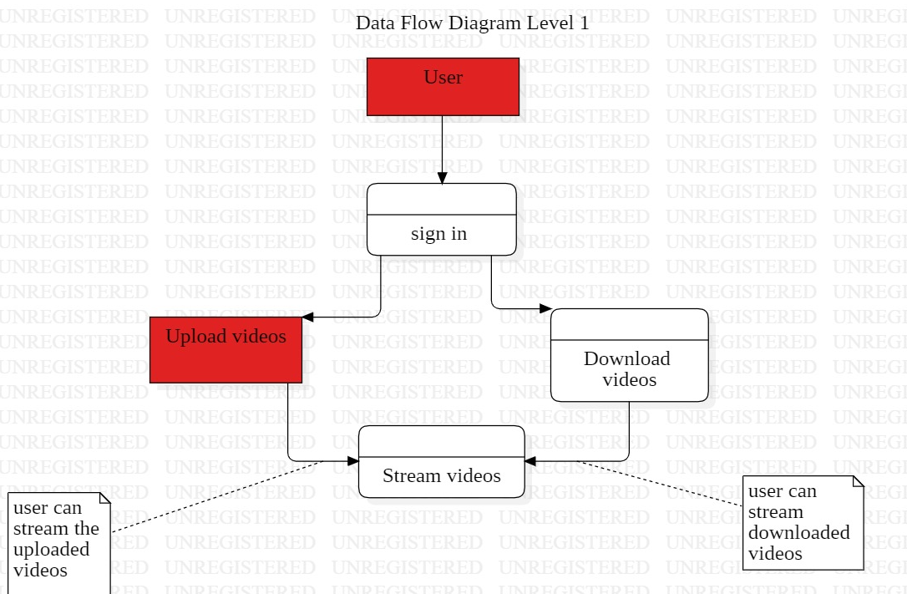
Working Model

Slide 13
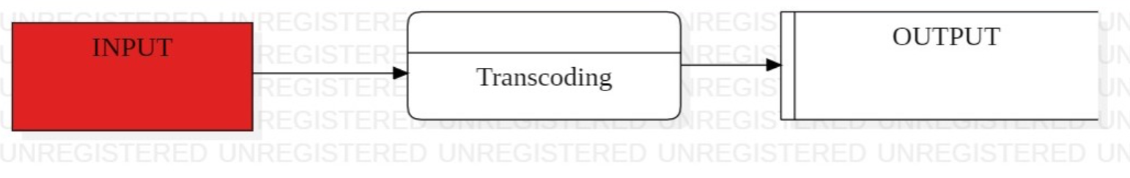
Working Model
Level 0 DFD

Slide 14
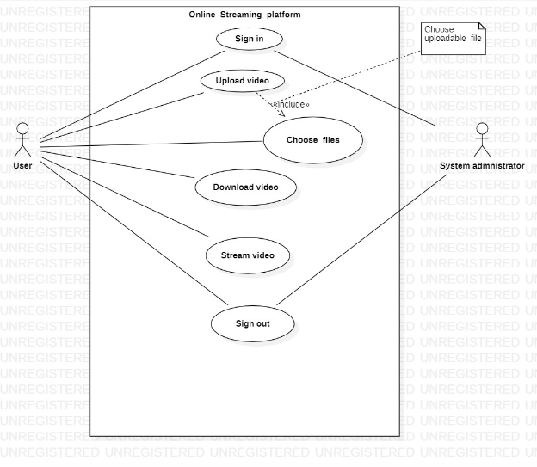
Working Model
Use Case Diagram

Slide 15
Area Of Application
There are numerous reasons why live streaming have various application in the business. driven scenarios some of them are as follows-:
Companies can also use live broadcasts to enhance and maximize direct communication with customers and community partner .
Live streaming an event allows you to reach and interact with more people across the world. One of the top advantages of live streaming is that you can connect with a wider, worldwide audience.

Slide 16
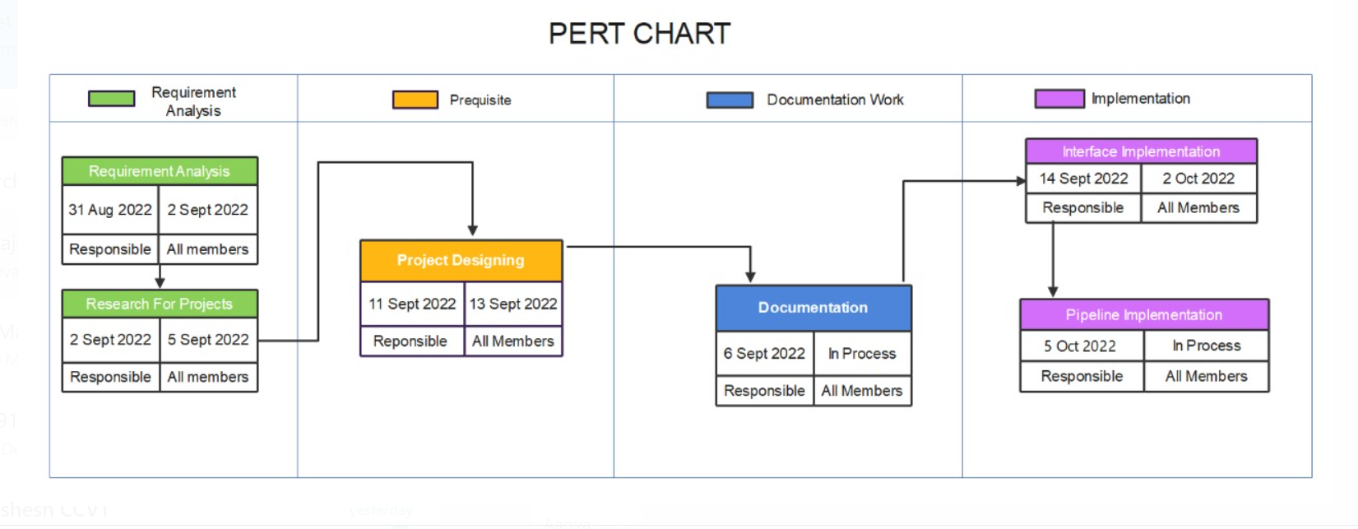
Pert Chart

Slide 17
Reference
Agrawal, P., Zabrovskiy, A., Ilangovan, A., Timmerer, C., Prodan, R., “Fastttps: fast approach for video transcoding time prediction and scheduling for http adaptive streaming videos.” Clust. Comput. 24(3), 1605–1621 (2021).
Li, X., Darwich, M., Salehi, M. A., & Bayoumi, M. (2021). A survey on cloud-based video streaming services. In Advances in Computers (Vol. 123, pp. 193-244). Elsevier.
Iturriaga, S., Goñi, G., Nesmachnow, S., Dorronsoro, B., & Tchernykh, A. (2018, September). Cost and QoS optimization of cloud-based content distribution networks using evolutionary algorithms. In Latin American high performance computing conference (pp. 293- 306). Springer, Cham.
Agrafiotis, I., & Kul, G. (2021). Guest Editorial: Special Issue on Advances in Insider Threat Detection. J. Wirel. Mob. Networks Ubiquitous Comput. Dependable Appl., 12(2), 1-2

Slide 18
Thank You

